Slide 1
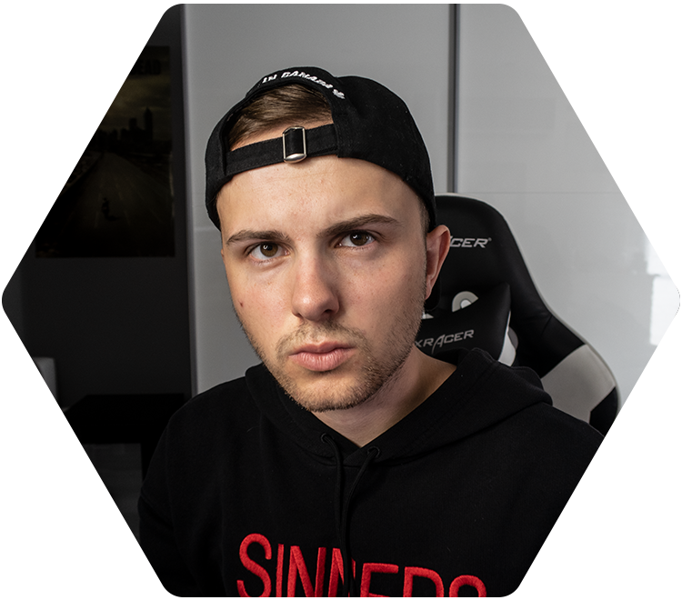
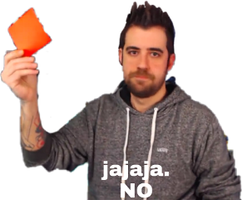
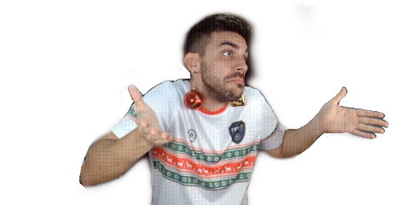
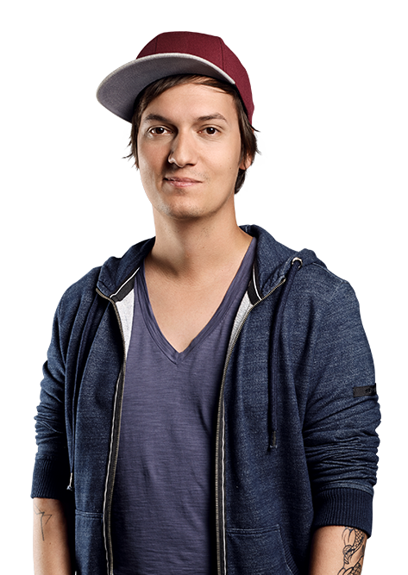
Influencers
How do they influence us?

Slide 2
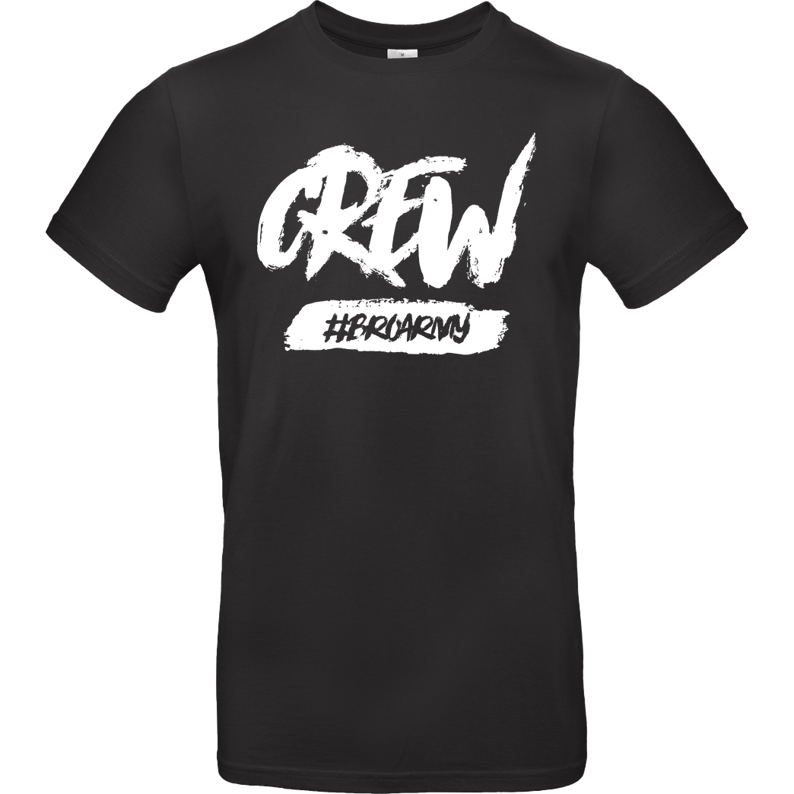
Germany
How do they influence us?
Merch
Advertising
serious talks
Content

Slide 3
Spain
How do they influence us?
Entertainment
Content
Opinions
Lies

Slide 4
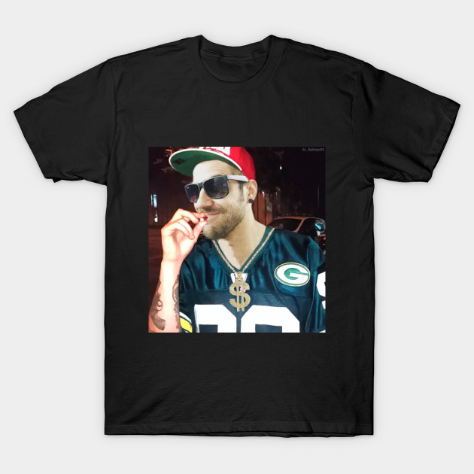
Merch and advertising
They release merch and we buy it
They promote something and we buy or do it

Slide 5
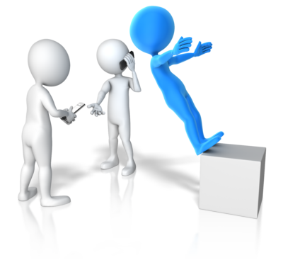
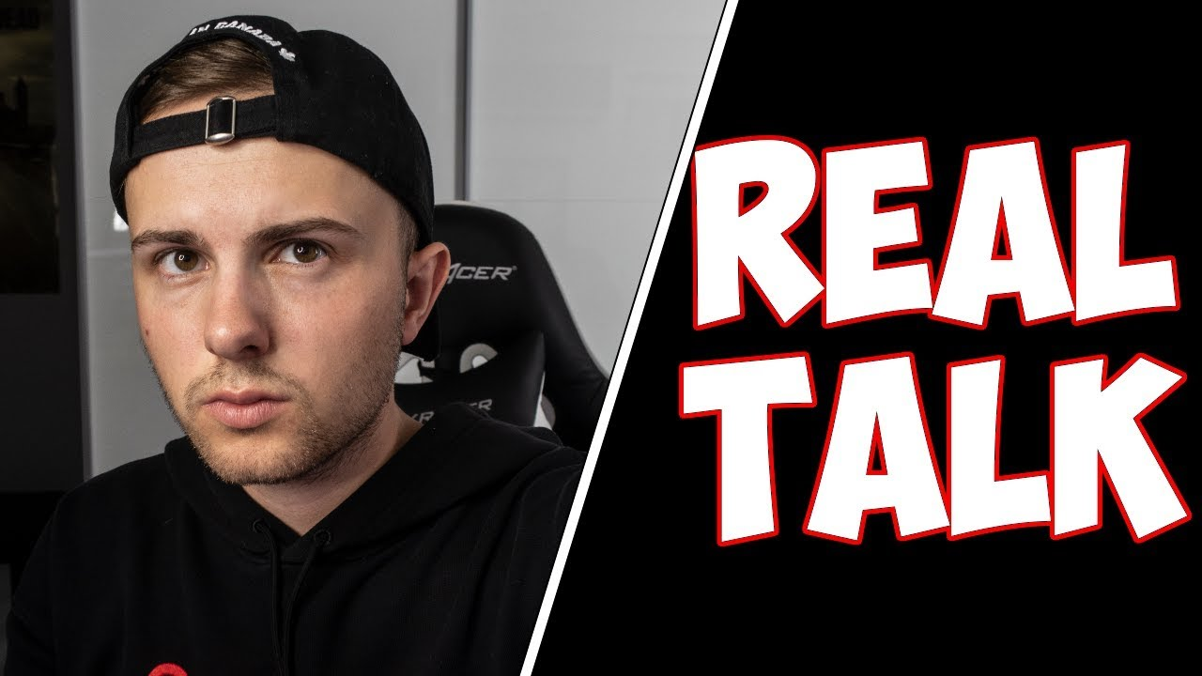
"Realtalk", ideas and lies
They tell us their sentiments and we get affected
They talk about a serious topic and we share the same opinion
Some Influencers tell lies and we trust them and believe anything they say
us
Influencers

Slide 6
Examples
Someone watches "MotoVlogs" and got influenced. Now he rides his own bike.
An influencer promotes his own merch. Now, a girl bought the merch.
Two influencers kid their young viewers and they start to believe.

Slide 7
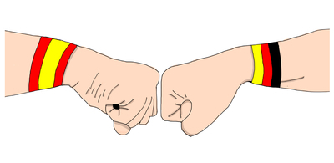
The End
„The End“
By Jaime, Eduardo and Samuel

