Slide 1
Etwinning Project

Slide 2
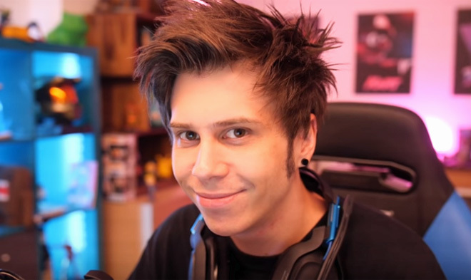
ElRubius
He is a spanish YouTuber who has almost 34 million suscribers.
He started creating videos since 2005, the exact same year that YouTube was created.
He was born in 1990,so he is now 29 years old.
He upload videos playing the fool and make people laugh.
He is the most famous youtuber in Spain

Slide 3
DjMariio
DjMariio is a Spanish youtuber who is 28 years.
He was born the 30 August 1990 in Mostoles.
He has 4,9 millions suscribers on YouTube and he upload videogames like FIFA 19 and Fortnite.
His first video was uploaded in 2009,there was a video of Call Of Duty.

