Slide 1
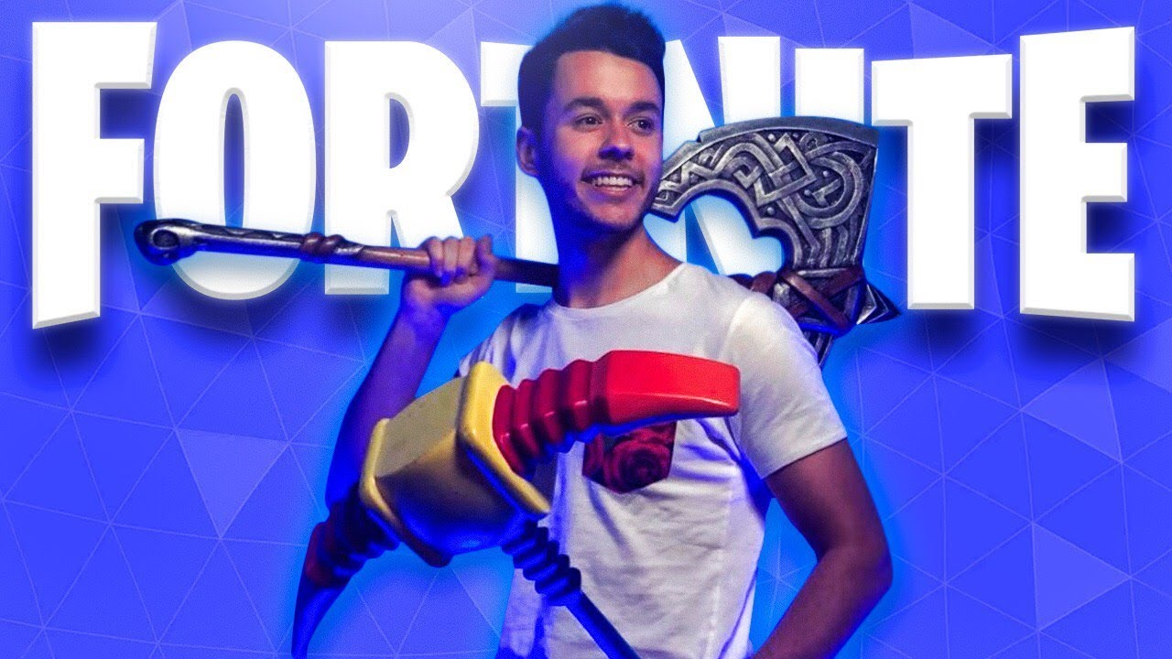
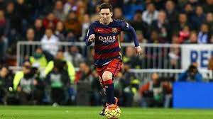
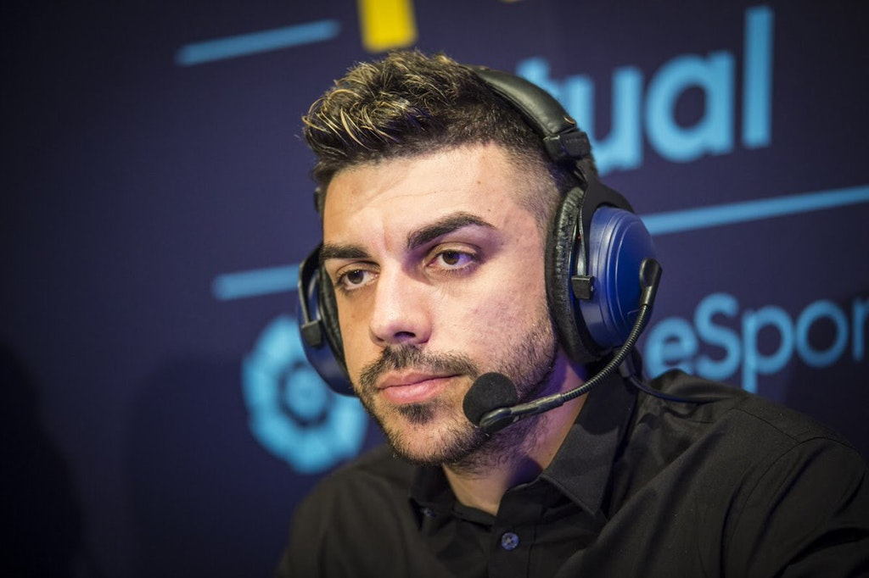
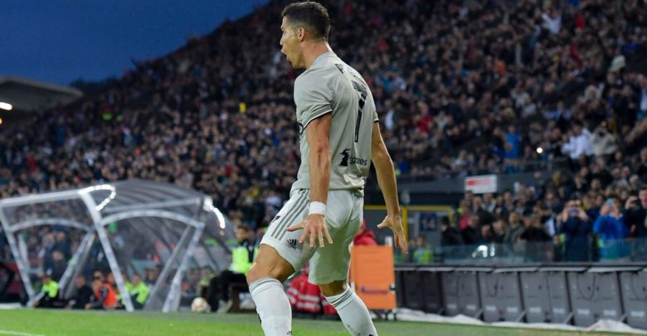
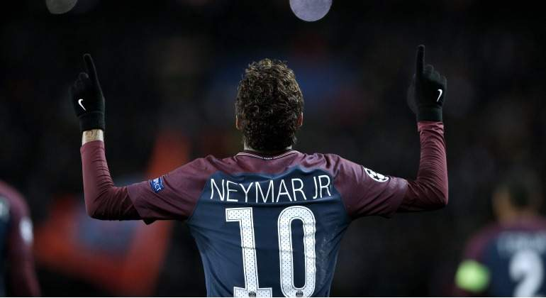
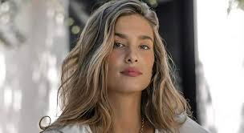
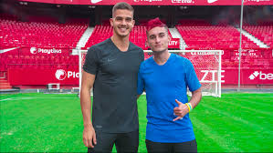
influencers

Slide 2
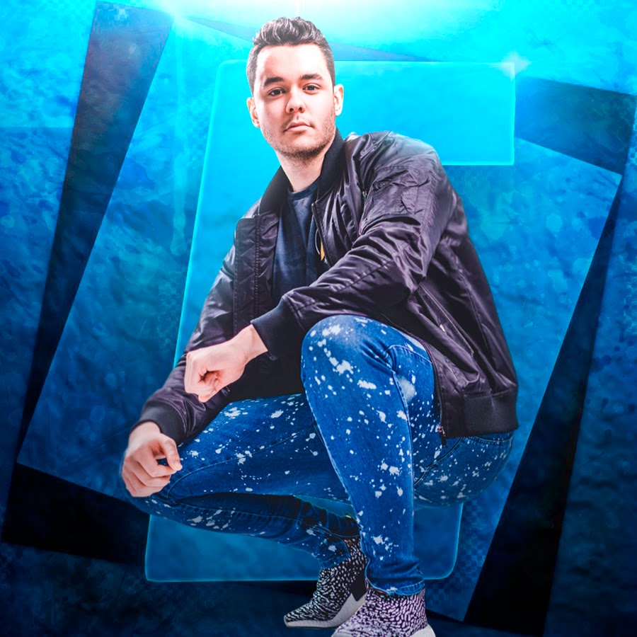
THEGREFG
Thegrefg is a very famous Spanish youtuber with 10 million subscribers on youtube. This youtuber influences many people to buy and play ''fornite'' one of the most popular videogames for young people.he influences these people since he is a content creator of this game.
He also use other socials networks like instagram twitter, mixer and facebook

Slide 3
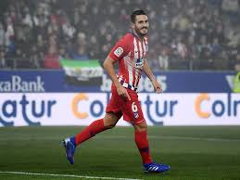
KOKE
koke is a Spanish footballer who currently plays in atletico de madrid. This footballer is with adidas so most of his clothes especially the football boots are of this brand. Koke influences many children to buy their football boots because koke is their idol and they want to wear the same as hi.

Slide 4
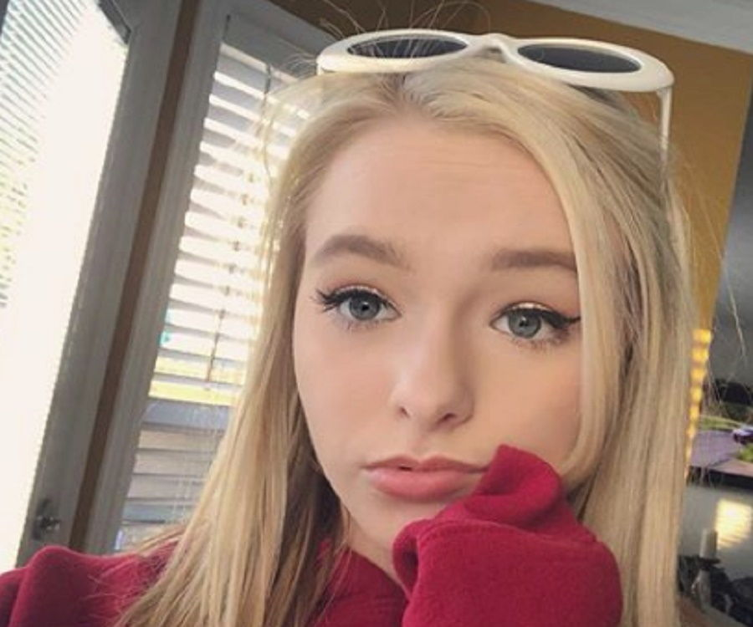
ZOE LAVERNE
Zoe laverne is a famous german influencers that is a sensation of TikTOk app where you can do videos dancing or doing strange things with music. She has has more than 4.1 million fans in the application ans she Post videos of lip sync in TikTok and also answer questions from her fans through vlogs.

Slide 5
JULIA BEAUTX
She is a famous german influencer especially for teenager, who talks about beauty, lifestyle, and DIY ( Do it yourself) crafting YouTuber. She has over 1.6 million subscribers on YouTube and 2 million followers on Instagram. Her videos consist of tutorials, challenges, tags, and more.

Slide 6
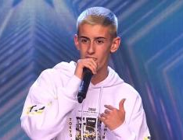
EL CEJAS
EL CEJAS IS A SPANISH INFLUENCER THAT UPLOAD VIDEOS OF HUMOR WHERE HE INTERPRETATION A CHARACTER CREATED BY HIMSELF
HE HAVE 1.4 MILLION OF FOLLOWERS AND GETTING IT VERY QUICKLY

Slide 7
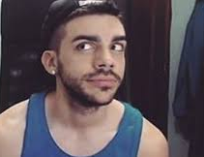
DJ MARIO
HE IS THE MOST IMPORTANT YOUTUBER OF FIFA IN SPAIN WITH 5 MILLIONS OF SUBSCRIBERS AND ONE OF THE MOST IMPORTANT INFLUENCERS
LOTS OF BOYS AND MENS BUY THE GAME FOR HIS VIDEOS
HE IS VERY FAMOUS FOR HIS ANGERS

