Slide 1
INFLUENCERS

Slide 2
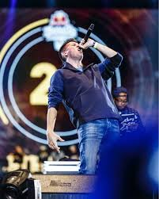
CHUTY
Chuty ,is an artist who dedicates himself to improvising, he battles against another artist to decide who wins a tournament or competition.
His intelligence and ingenuity make it one of the best in history that makes children notice him.
He also has won many titles.

Slide 3
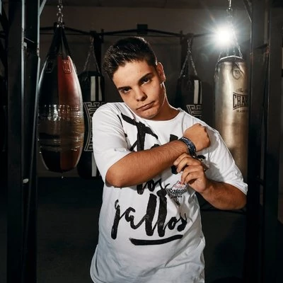
FORCE
Force is a freestyler and also youtuber who competed against Chuty to win the national competition , also uploads to youtube videos reacting to battles and giving his opinion.
Is an example of overcoming because he suffered bulling and with work he ended up getting his dream.

Slide 4
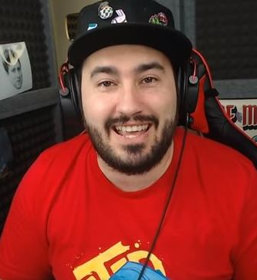
LOLITO FDEZ
Is a professional player of fornite that is a survival game.
He plays from home, like any other teenager. He is an example of being overcoming because he was addicted to cocaine and now earns his living playing videogames .

Slide 5
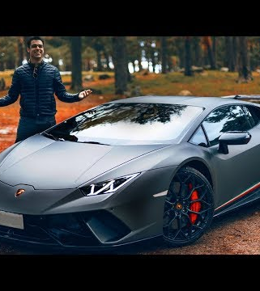
Alphasniper
Is a youtuber that uploads videos of call of duty, has 3 million subscribers, and he achieve to buy the car of your dreams a lambhorgini.

