Slide 1
INFLUENCER

Slide 2
What is the function of an influencer?
An influencer is an individual who has the power to affect purchase decisions of others because of his/her authority, knowledge, position or relationship with his/her audience.

Slide 3
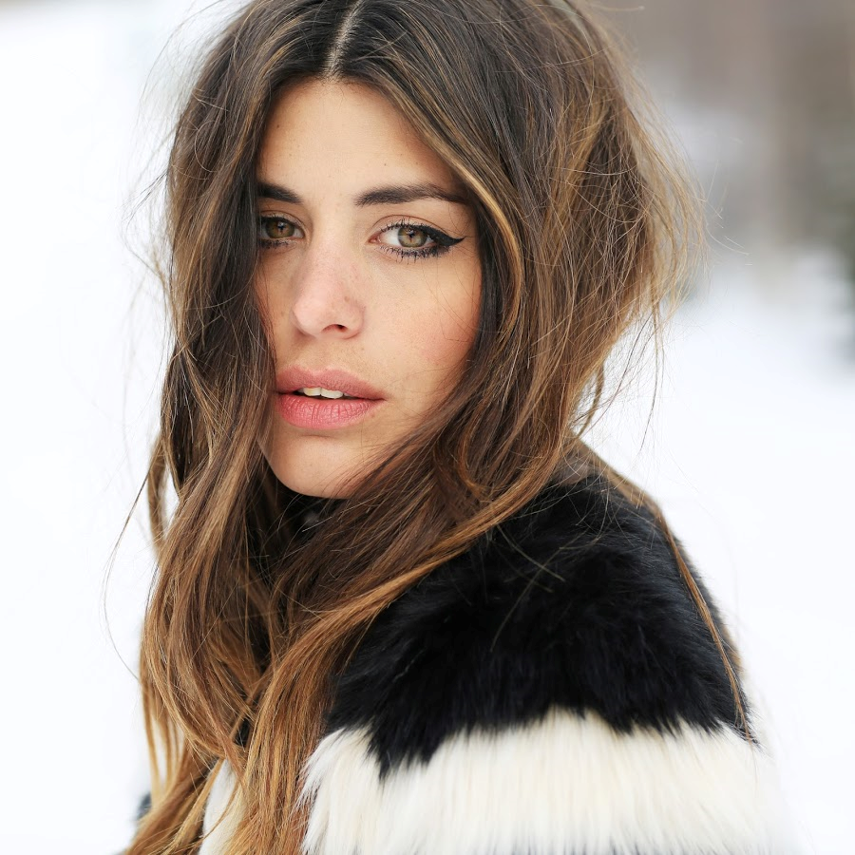
DULCEIDA
Spanish fashion blogger best known for her YouTube channel and blog, both titled Dulceida. She has gained a massive audience by posting her fashion tips and daily style. She has more than 2.5 million followers in Instagram and over 2 million subscribers on YouTube.

Slide 4
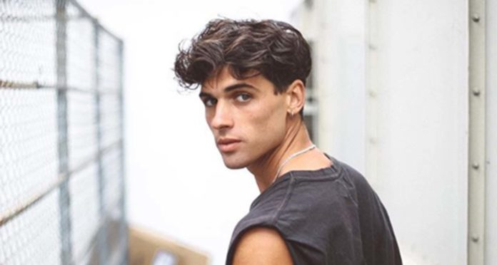
DANIEL ILLESCAS
He is Catalan and is a lover of risk sports. He has been a model since he was fourteen years old and he has more than half a million followers on Instagram and more than a hundred thousand subscribers on you tube.

Slide 5
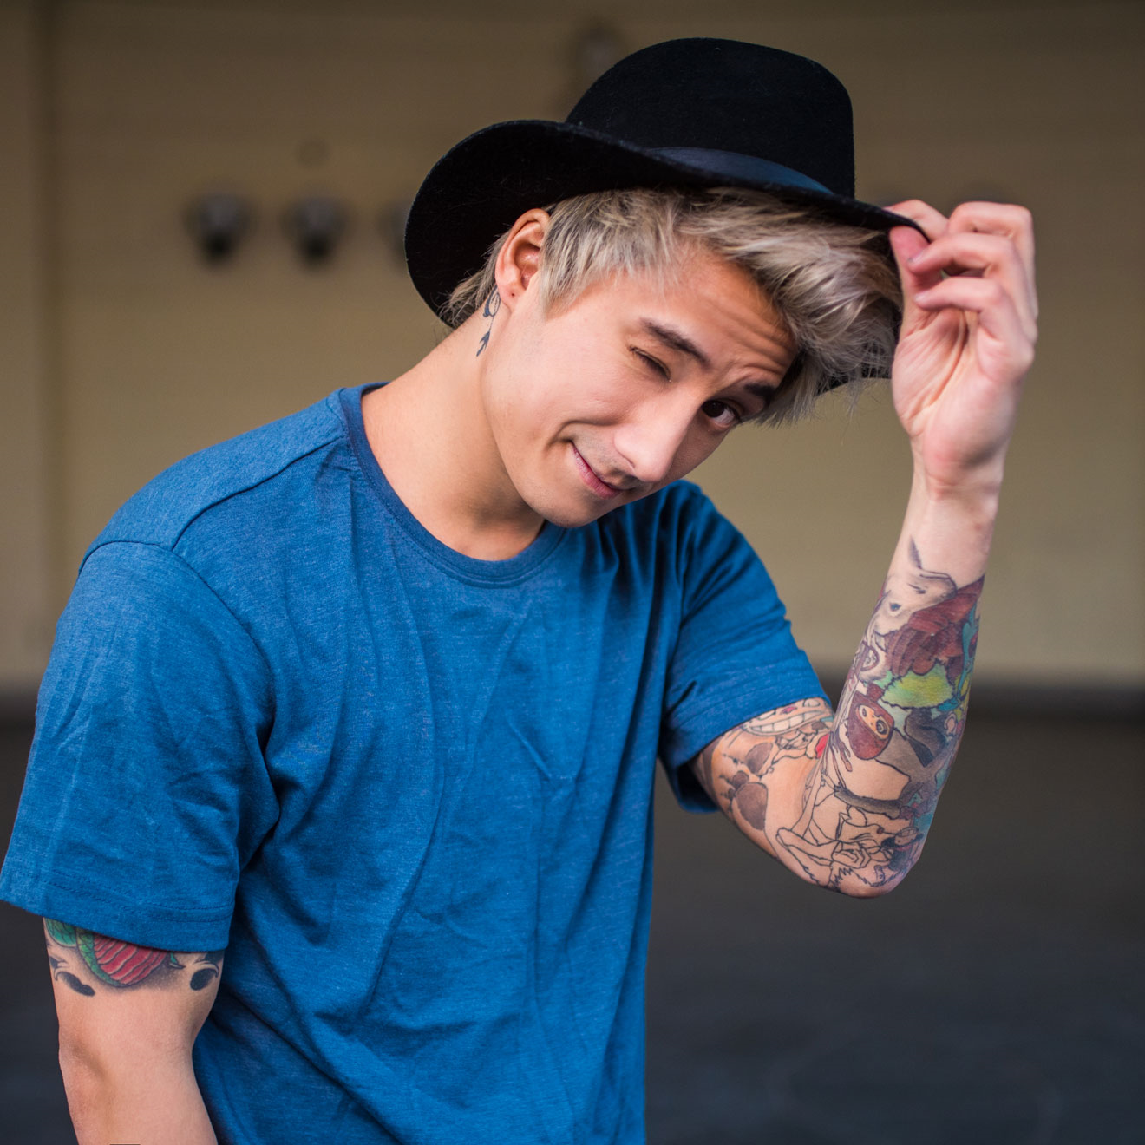
JULIEN BAM
Is a german youtuber. He is known for his youtube channel and he has comedy, dance and music videos on his channel. On YouTube he has more than 5 Million subscribers and on Instagram more than 3 Million followers. His full name is Julien Zheng Kho Budorovits and he is one of the ost succesful german youtuber.

