Slide 1
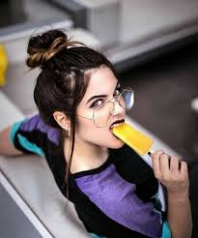
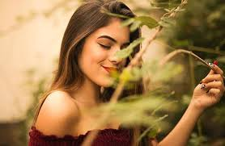
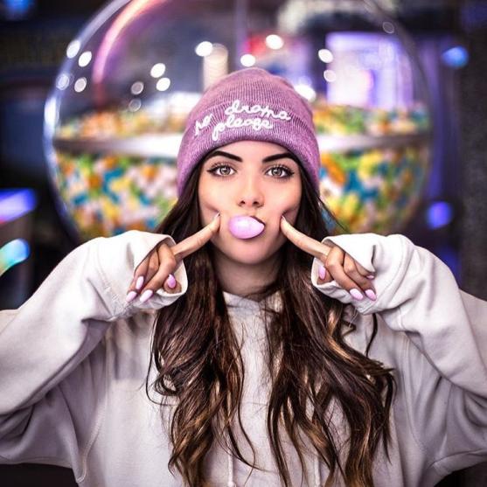
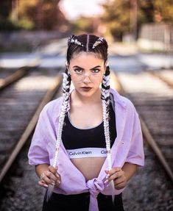
Lucia bellido

Slide 2
biography
Lucia bellido serrano has 15 years old and lives with her parents in Barcelona
She has a YouTube channel
she is a homemade girl who likes to be with the family and loves dogs and has one called dayron
at first her classmates laughed at her because they thought it would not come to anything but then to achieve fame alone the people who made fun of her now asked tik toks to raise of likes being interested

Slide 3
lifestyle
She usually reports to her instagram followers about her stories ,about her life ,which makes
She also makes many collaborations with brands and then raffles.i also like to make lots of hangouts with their fans in specific places and sometimes go to music festivals to meet more fans .

Slide 4
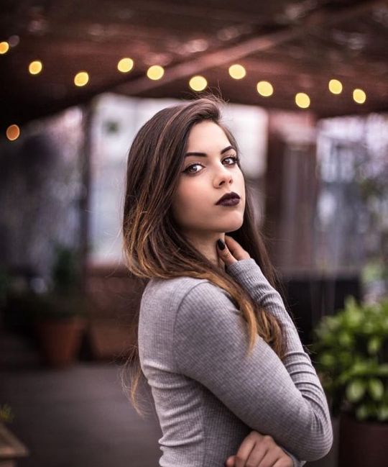
How has she influened ?
Lucia started on VideoStar (@videostarbellido_) with only 12 years old and captivated with her great personality and was gaining followers. When the TikTok app (@ its.bellido) was taking more strength and only here that its fame increased a lot more. Now she is one of the biggest influencers in Spain .

Slide 5
Curiosities
She is 15 years old but she looks 18
She has her own book in which she talks about her life.
She has 1,2 thousand followers on instagram
And 2,4 thousand followers on tik tok

