Slide 1
Marina Yers
By: Marta María Márquez
Pia
Álvaro Gómez

Slide 2
Biography
Marina Yers was born in Septembee of 1999 in the Ukraine and she would later settle in United Kingdom.
When she was 8 months, she had cancer of the kidney.
She lived in Ukraine just until she was 7, and all those years, her mother worked in Polonia. This is the reason by which she lived with her grandparents.
She had a relationship with an Spanish YouTuber called DualCoC.
Her younger brother appeared with her in March 2017 on a video called “Si te ríes pierdes con mi hermano” in English “ If you laugh you lose with my brother”.
She is now living in Madrid.
She is now 19 years old, and her birth sign is Virgo.

Slide 3
Facts
Marina Yers was born in Ucrany and the moved to Great Britain.
Marina Yers is 18.
She is an Spanish-language Youtuber.
She earned 1.3 million subscribers by posting stories, tags, social media tutorials and more.
Her channel Was created in September 2013, although she didn’t post a video until 2016.

Slide 4
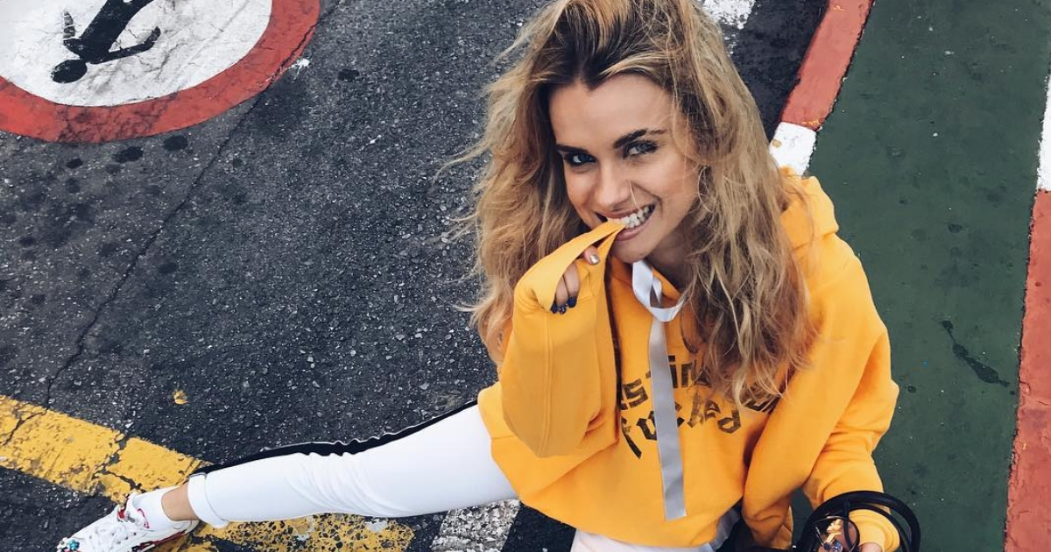
Her appearance

